Slide 1

COMPUTER NETWORKS (BCSC 0008)
Copyright content, use only with the written permission of presenter mentioned
Lecture 2

Slide 2
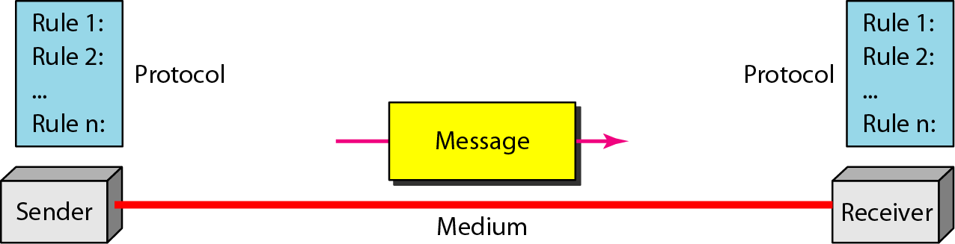
Analyzing components in N/W
Previously discussed components are
Sender
Receiver
Message
Medium
Protocol

Slide 3
Network Models
Network models use layers to describe networks
Each layer describes the services provided to the layer above it and those required from the layer below it
It also describes the format of exchanges between peer layers on different network hosts
Because the layers “stack” on top of one another, we often refer to network protocol “stacks” when we talk about the implementation
Layer N+1
Layer N+1
Provides
Exchanges
Layer N
Layer N
Requires
Building complex systems is hard!
Approach: “Divide and conquer”.
Split job into smaller jobs, or layers.
Layer N-1
Layer N-1
Each step dependent on the previous step but does not need to be aware of how the previous step was done.

Slide 4
Analogy: Air Travel
The problem: air travel.
Decomposed into series of steps:
Arrival at airport
Check-in
Boarding
Takeoff
Departure from airport
Baggage claim (check out)
Deplane
Landing
Traveling

Slide 5
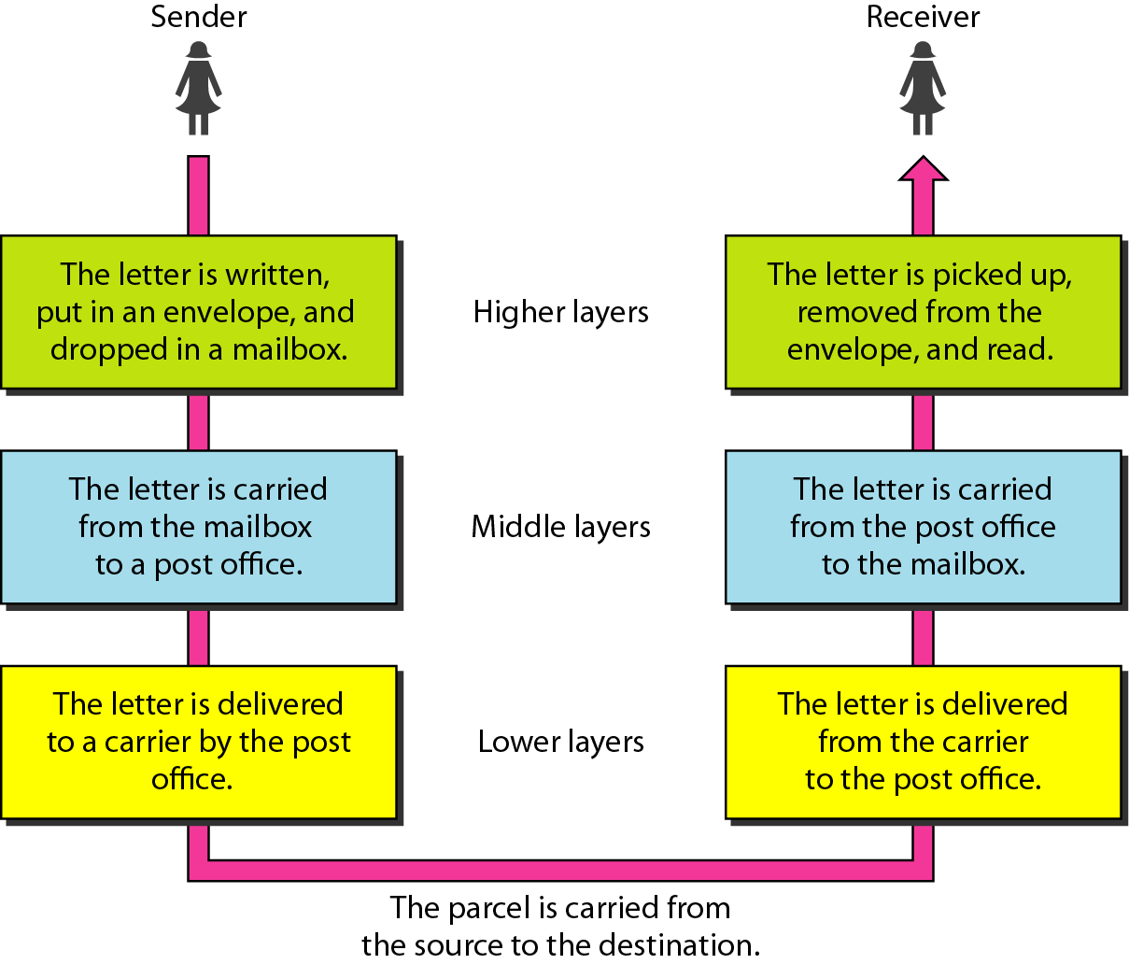
Tasks involved in sending a letter ( Ref Fourouzan )
Task of communication broken up into modules

Slide 6
Network Models
The most well-known network model is the OSI (Open Systems Interconnect) Reference Model defined and maintained by the Organization for International Standardization (ISO)
It consists of seven layers, numbered from the bottom (closest the network) to the top (closest the user)
Layer 7 – Application
Layer 6 – Presentation
Layer 5 – Session
Layer 4 – Transport
Layer 3 – Network
Layer 2 – Data Link
Layer 1 – Physical

Slide 7
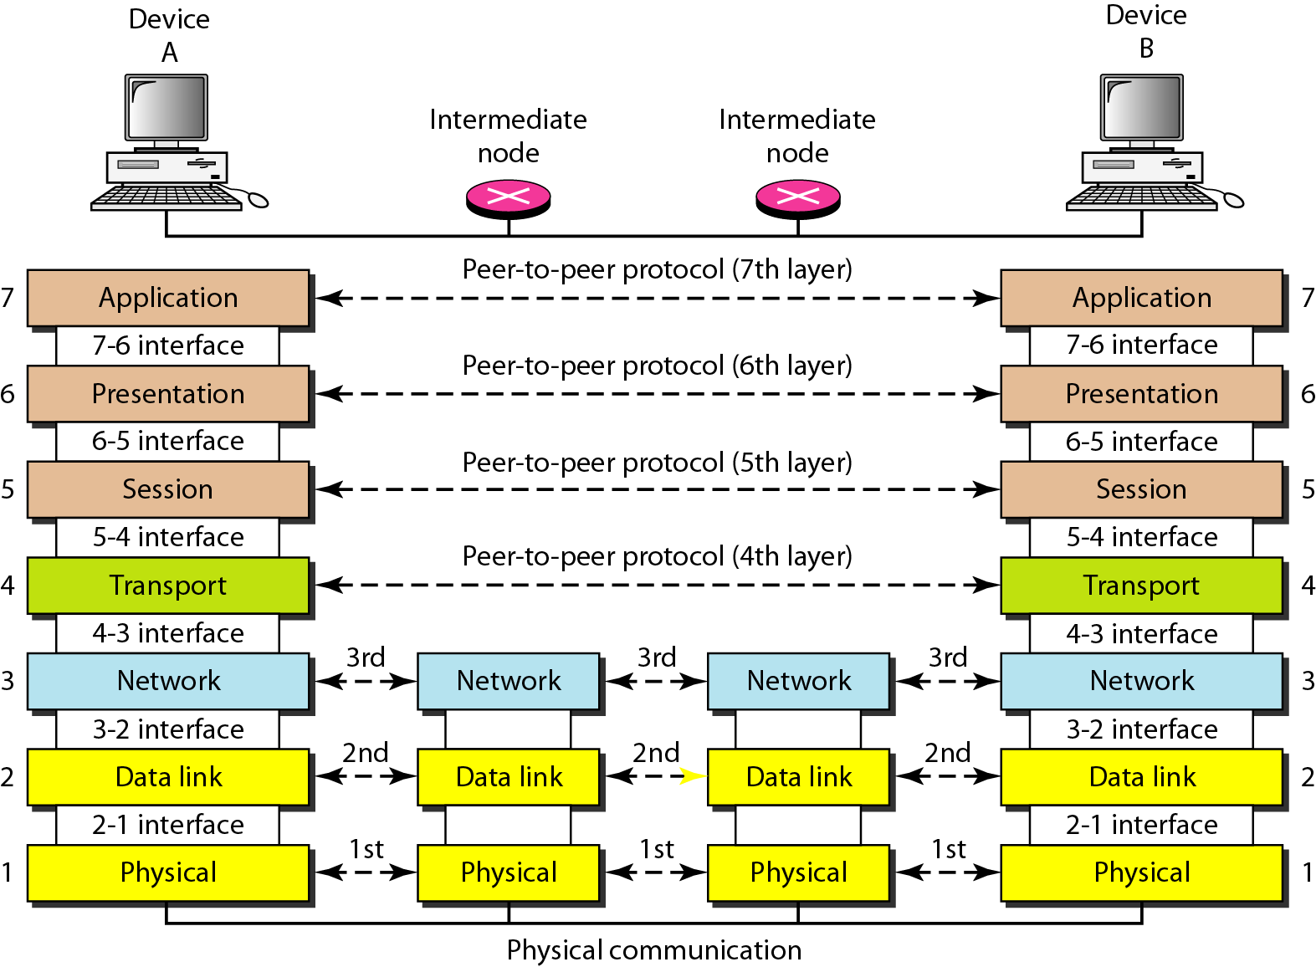
The interaction between layers in the OSI model

Slide 8
Encapsulation/Decapsulation
At Sender Site, each layer add its own information to the data received from its upper layer ( Called as HEADER). ( HEADER + DATA= DATA for next lower layer)
This HEADER can be accessed (add/remove) only by specific layer
At Receiver Site, This HEADER is removed ( on matching certain conditions) only by the layer that has added the HEADER at sender site.

Slide 9
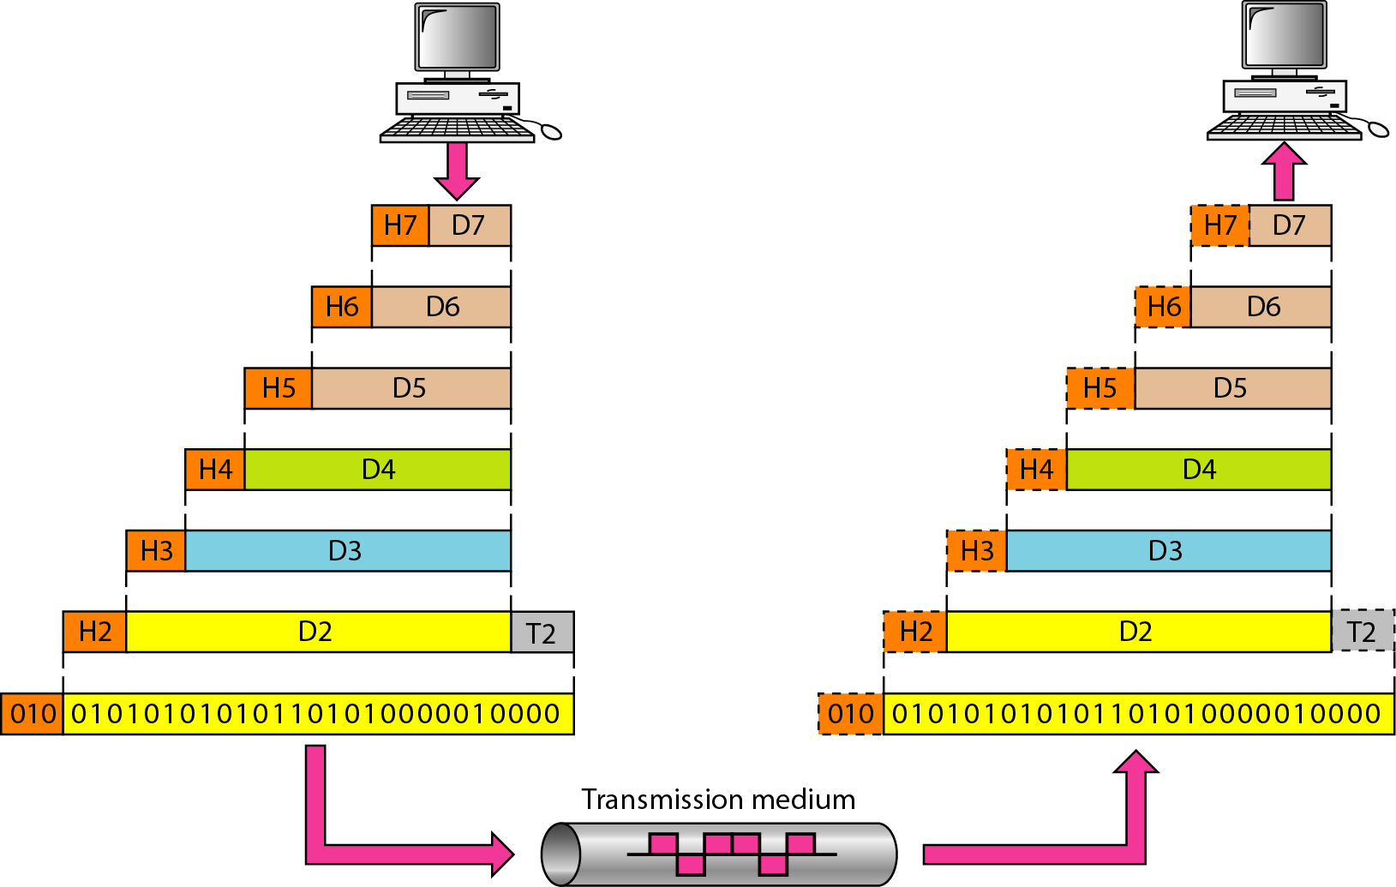
Each Layer in OSI model provides different SERVICES

Slide 10
OSI Reference Model
Layer 1 – The Physical Layer
Defines the type of media to be used
What order are bits transmitted (if serial or parallel)?
Data Rate or Transmission Rate
Line Configuration (P2P / MP)
Physical Topology
Transmission Mode ( Simplex, Half/ Full Duplex )
Defines representation of data on the medium
Is a ‘0’ “high” or “low”, “on” or “off”?
Layer 1 – Physical
The physical layer is responsible for movements of
individual bits from one hop (node) to the next.

Slide 11
OSI Reference Model
Layer 2 – The Data Link Layer
Defines “right to transmit” rules (Access Control)
Provides directly-connected hop-to-hop data transfer (Hop to Hop / Node to Node Delivery)
Defines higher-level structure of data (frames)
Defines “physical” address structure for hosts (Physical Addressing)
Error Control
Flow Control
Layer 2 – Data Link
Layer 1 – Physical
The data link layer is responsible for moving frames from one hop (node) to the next.

Slide 12
OSI Reference Model
Layer 3 – The Network Layer
Provides end-host-to-end-host data transfer across multiple data links (host to host/ source to destination delivery)
Defines higher-level structure of data (packets)
Defines “abstract” address structure for host (Logical Addressing)
Routing
Delivery and Forwarding
Layer 3 – Network
Layer 2 – Data Link
Layer 1 – Physical
The network layer is responsible for the delivery of individual packets from the source host to the destination host.

Slide 13
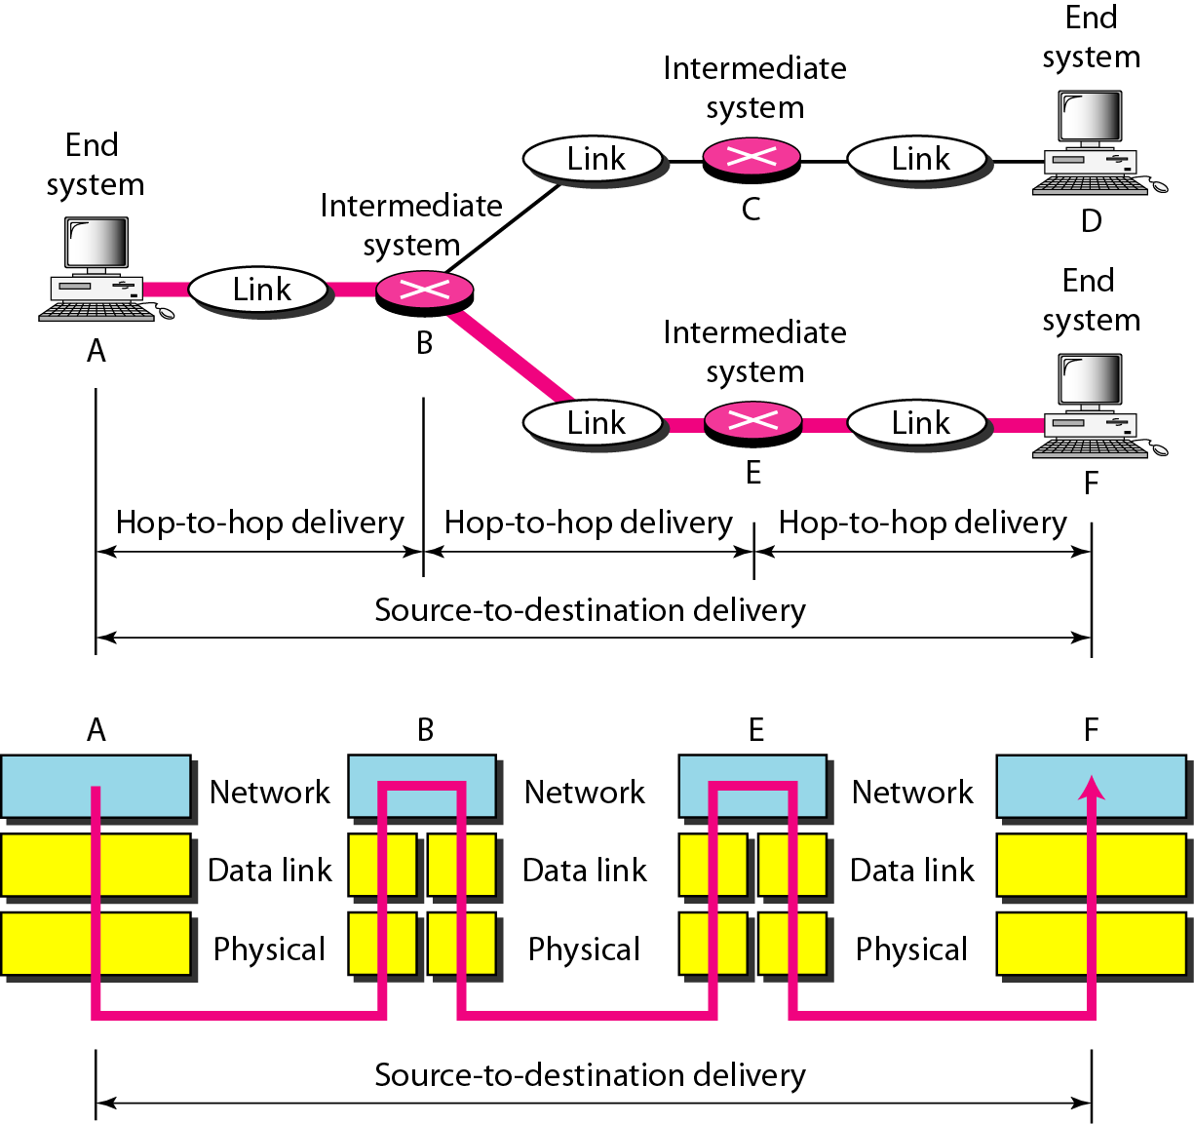
Figure 2.9 Source-to-destination delivery
Data Link Layer- Hop to Hop
Network Layer- Source to Destination

Slide 14
OSI Reference Model
Layer 4 – The Transport Layer
Provides process-to-process data transfer
May provide for reliable data transfer
Defines higher-level structure for data (datagrams, streams, etc.)
Defines “port” addresses for services (processes)
Layer 4 – Transport
Layer 3 – Network
Layer 2 – Data Link
Layer 1 – Physical
The transport layer is responsible for the delivery of a message from one process to another.

Slide 15
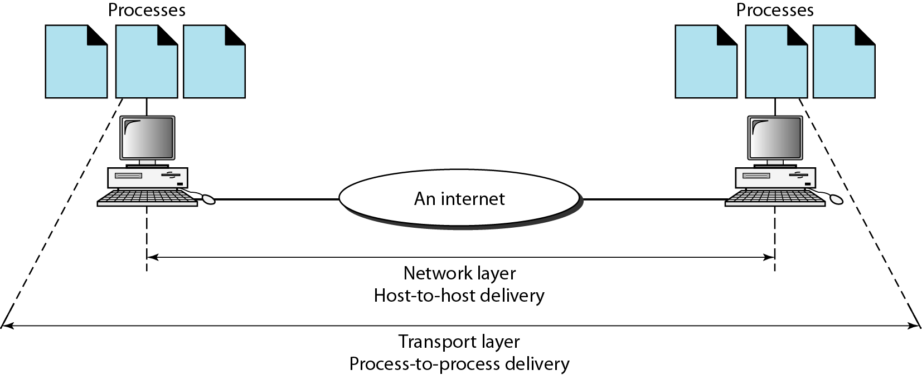
Figure 2.11 Reliable process-to-process delivery of a message

Slide 16
OSI Reference Model
Layer 5 – The Session Layer
Provides a logically persistent connection between processes
May involve user or host authentication (login), transaction encapsulation (for database access), etc.
Layer 5 – Session
Layer 4 – Transport
Layer 3 – Network
Layer 2 – Data Link
Layer 1 – Physical
The session layer is responsible for dialog control and synchronization.

Slide 17
OSI Reference Model
Layer 6 – The Presentation Layer
Defines the network representation of data
Converts between the network and host representations of data (ASCII/EBCDIC, byte order, encryption, compression, etc.)
Layer 6 – Presentation
Layer 5 – Session
Layer 4 – Transport
Layer 3 – Network
Layer 2 – Data Link
Layer 1 – Physical
The presentation layer is responsible for translation, compression, and encryption.

Slide 18
OSI Reference Model
Layer 7 – The Application Layer
Provides a portal for the application to access the network
Describes the dialog between two applications communicating across the network.
Layer 7 – Application
Layer 6 – Presentation
Layer 5 – Session
Layer 4 – Transport
Layer 3 – Network
Layer 2 – Data Link
Layer 1 – Physical
The application layer is responsible for providing services to the user.

Slide 19
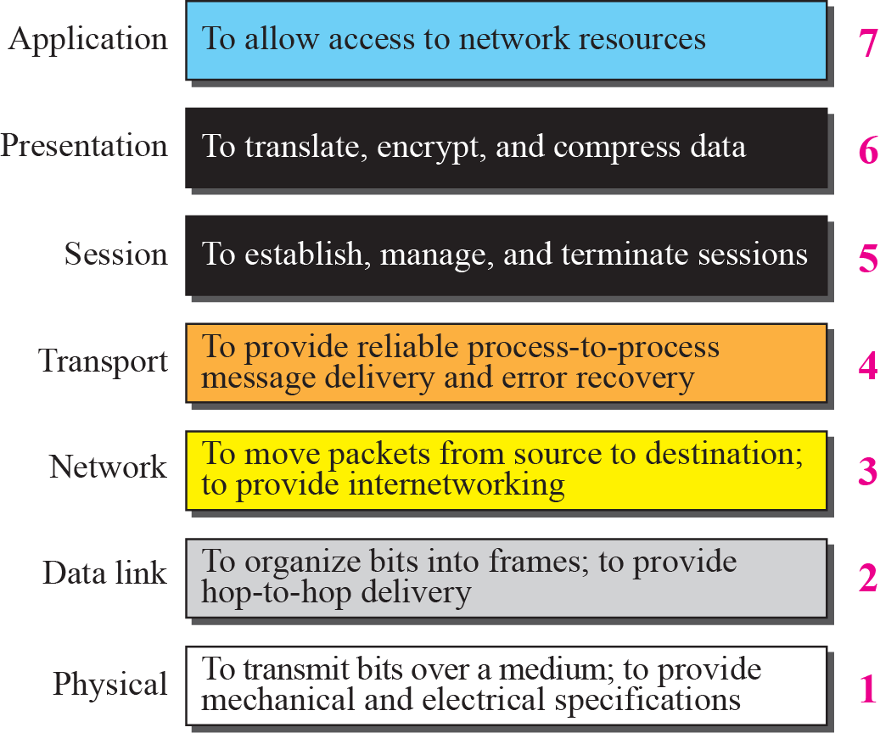
Summary of OSI Layers

Slide 20
Thank You
Discussion & Doubt session will be in lecture.
Delivered By: Shabir Ali
Important terms to keep in mind
Network Model
Encapsulation / Decapsulation
Peer to Peer process
OSI model and services of layers

